Slide 1
Filter dropdown values
12th June 2021

Slide 2
Div ng-repeat
input
div
input
/div
div
input
/div
div
input
/div

Slide 3
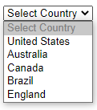

Slide 4
